Slide 1
Unit III Object Oriented Programming

Slide 2
After this session we are able to response about
following topics:
What is Object Oriented Programming
How is different from Procedure Oriented Programming
Example related to OOP

Slide 3
Object-oriented programming (OOP) is a way of solving a problem in which programmers define the data type related to it along with the types of operations that can be applied over a sub problem.
Another way to think about OOP is that it separates our program into multiple parts and each part contains some code along with some data.
These multiple parts are referred as classes where each one of them together contains functionality and data required to process it.

Slide 4
Apart from OOP and prior to it there is one more way of solving a problem is Procedure Oriented Programming (POP).
A POP is a sequence of procedures or say functions where each one having its own set of data structures.
Also each procedure proceeds its set of codes and the control of program move towards given next procedure.

Slide 5
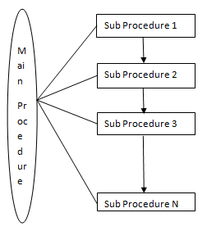
POP is also termed as structural programming.
As mentioned in above image, in POP all functionality related to a problem are linked with a main procedure and all sub procedures will executed one after the another.

Slide 6
However such programming approach is not good for complex problems.
This is because there is lack of communication between each sub procedure in terms of sharing information.
Although using "return" and "global" keywords we can communicate between main and sub procedure but not within sub procedure especially when there is a need of accessing same information by two or more sub procedure.

Slide 7
In OOP we can communicate within different modules in terms of data and information.
Each modules are constructed in such a way that each one have some attributes or say data structure and some methods.
These modules in OOP is termed as classes and the instances of it is termed as objects.
These objects can communicate with each other, can be defined as many as times we need and even if we there is requirement to update or upgrade something we can easily perform it.

Slide 8
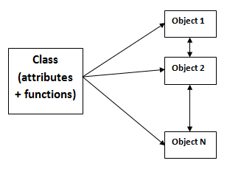
So a class is like a template or a blueprint on the basis of which we can create many objects and each one having its own values and functionality respectively.
Attributes for a class will be those data types which will participate in any defined functionality. Functions are defined in such a way that it must represent the common functionality for a given problem by including all given attributes.
For example, "Course" is a class.

Slide 9
It may include following functionality like "recruitment of teachers", "Add students", "Assigning Section", "Allotment of Enrollment/Roll Numbers" and so on.
The objects belonging to this class will be "BTech", "BCA", "BSc(IT)", "MCA" and so on.
Note that as a programmer we have freedom to decide the attributes and functions for classes and defining objects based on them.
But still it is important to arrange them into some logical manner so that we can create multiple objects based on that class.

Slide 10
